Slide 1
CS4499/5599: Data Science and Applied Machine Learning
Class Lecture: March 1st, 2023

Slide 2
Objectives
Last time:
The role of data in machine learning
Issues facing machine learning
Today:
Steps to develop machine learning models
Introduction scikit learn
Data preprocessing

Slide 3
Knowing when to Apply a ML Model
Due to the current excitement of the possibilities in machine learning, people are exploring different possibilities
Many organizations have explored the use of machine learning for things like resume filtering
The idea is to see if they can find the “perfect” candidates for positions
This practice has gone under a lot of scrutiny, and there have been claims that the models treat some groups unfairly
When deciding if a machine learning model is an approach for a problem, make sure to ask yourself is this a task for a machine or a person to do

Slide 4
Developing Machine Learning Models
Step 1 Frame the Problem
Without a clear objective, starting a ML project is difficult
Once you determine what you want to learn or predict things come into focus very quickly
Decide if you will be predicating a value (regression model) or if you are looking to identify something (classification)
By the time we are finished with this class, this will likely be second nature to you

Slide 5
Developing Machine Learning Models
Step 2 Find Data
No machine learning model is possible without a dataset
Data collection can be a long-time consuming process
Luckily for us there are a number great free sources we can use to find data
Sources:
UC Irvine Machine Learning Repository
Kaggle
Amazon AWS
The U.S Federal government collects and maintains numerous datasets which are valuable for research

Slide 6
Developing Machine Learning Models
Step 3 List and check any assumptions
Doing this can help you identify and potential issues with your approach to the problem, data and by extension your model before you get to work
Machine learning can be computationally expensive, you do not want to begin training models unless you are sure you are on the right track

Slide 7
Developing Machine Learning Models
Step 4 Explore the Dataset
Many data scientist tend to forget this step and try to go straight to data preparation
Don’t fall into this trap, before you get to work on manipulating the data verify your data
Make use of .describe, .info and other Pandas methods
This will save you time and heartache down the road
Identify and manage major outliers
Deal with missing values
Determine what kind of data you are working with (numerical, categorical, etc.)

Slide 8
Developing Machine Learning Models
There are a number of other things we should do when we are exploring the dataset
Depending on what kind of data you have, you may consider using visualization to gain insight
Look for correlations in the data
If necessary, clean the data to ensure it is ready to be used in your model
Example: Say you have a dataset with missing values, what do you do?
You can remove the sample(s)
You can try and collect the information to fix the value(s)
You can set the value(s) to some consistent value

Slide 9

Scikit Learn
Scikit learn is considered the leading Python package for machine learning
Originally developed as a part of a Google project in 2007, the first release of scikit learn was in 2010
The company has received funds from several companies and groups across the world including Microsoft, Columbia University, NYU, etc.
Today scikit Learn is considered a standard for machine learning and is included in most data science distributions

Slide 10
Scikit Learn
Scikit Learn is a free open-source Python package and is include in the standard Google Colab library
Scikit Learn was designed to help guide data scientist through the entire model training process
The package contains methods and functions that help prepare data for use in ML models as well as train and validate models
Scikit Learn was built making use of several other Python packages such as NumPy, Matplotlib and Scipy

Slide 11
Scikit Learn
Many private companies make use of scikit learn for their own projects these include JP Morgan, Coca-Cola and Spotify
In research scikit learn has been cited in over 60,000 different studies
For the remainder of this class, we will be making extensive use of scikit learn
The package has the ability to train supervised machine learning models using 17 different approaches
The package also can train unsupervised models with a variety of different methods

Slide 12
Developing Machine Learning Models
Step 5 Data Preparation & Preprocessing
Once you have a model in mind for your project you can take your dataset and get it ready for training
The first thing you should do is ensure all your data is in the right format
The most common issue data scientist find is having fields containing categorical data
Scikit learn is not designed to handle this type of data, so we have to address it properly before we begin training

Slide 13
Categorical Data
Categorical data is most associated with data that can be divided into groups
Common categorical data we will encounter include:
Demographics such as gender, race, etc.
Geographical Regions: Country, state, county, etc.
Binary data such as yes or no
Categorical data can be divided into 2 categories:
Nominal data, where there is no numerical value association
Ordinal, where the data has scale

Slide 14
Ordinal Data
Ordinal Categorical data is easy to deal with Python, we just have to replace the category with a numeric value that represents the magnitude
Example:
Say our dataset contains the score with three categories “low”, “average” and “high”
To get this to work with scikit learn we will want to convert it to a 1,2,3 scale
Let do an example in Colab

Slide 15
Nominal Data
Dealing with nominal data is more involved than ordinal data
Assume we have a dataset of cars that we wish to create a model to predict price
In this case we may have several nominal data fields. Things like color, engine, etc.
Consider the color field, while the color of the car may have an impact on the price, however that impact isn’t likely uniform
If we were to apply the same approach as we did with the ordinal data, we would bias our model toward that feature
Instead we need to make use of dummy variables

Slide 16
Dummy Variables
Dummy variables are numeric representations of nominal categorical data that do not introduce bias
Dummy variables are very common in statistics, especially regression, but have use with classification models as well
Dummy variables are a set of values rather than just a single value
The accepted rule for dummy variables is 1 less than the number of classes in your
Example: If your column has 3 classes you will need two dummy variables (1,0), (0,1). (0,0) will be represent the 1st class
Sklearn’s OneHotEncoder or Pandas’ get_dummies will help you with this

Slide 17
Feature Scaling
Perhaps the most import data preprocessing method that needs to be done is feature scaling
It is not uncommon that datasets consist of data widely different features
Consider a dataset containing temperatures and pressures and a data point has a temperature of 1378 degrees Fahrenheit and a pressure of 5 MPa
The difference numerically between the two significant, but the just because the pressure has a smaller value doesn’t necessarily mean its is significantly less important than the temperature

Slide 18
Feature Scaling
While we can easily understand this possibility, machine learning models can’t
If these two variables were placed in their current form, the temperature be a dominate feature in most common models, this is known as feature bias
When our models contains data of different scale like this, we need to apply a scaler to make sure the features are weighted equally
Our goal is to get all the data in the same magnitude, but that the data still behaves the same

Slide 19
Feature Scaling
Scikit learn has several different approaches we can use
Here are six popular data scaling techniques, but be aware there are more
Standard Scaling
Robust Scaling
Min-Max Scaling
Normalization
Binary Scaling
Max Absolute Scaling

Slide 20
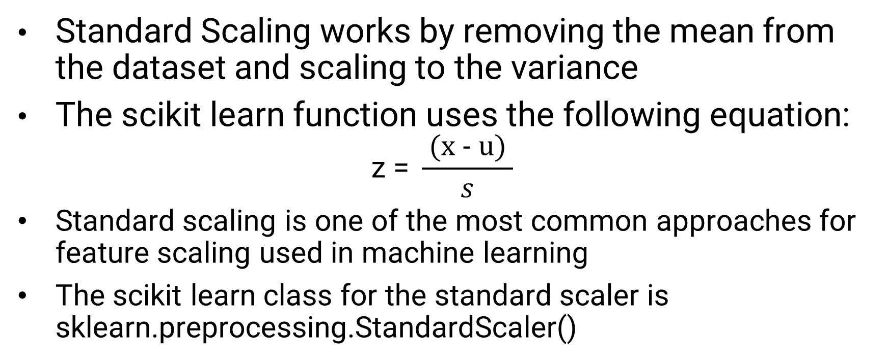
Standard Scaling
Standard Scaling works by removing the mean from the dataset and scaling to the variance
The scikit learn function uses the following equation:
$$\text{z}\text{ = }\frac{ \text{(}\text{x}\text{ − }\text{u}\text{) }}{s}$$
Standard scaling is one of the most common approaches for feature scaling used in machine learning
The scikit learn class for the standard scaler is sklearn.preprocessing.StandardScaler()

Slide 21
Robust Scaling
Robust Scaling removes the median and then scales according to a percentile range
This is especially handily if your dataset contains a number outliers, as the method will remove then and scale accordingly
The default range is between the 25^{th (1st)} and 75^{th (3rd)} percentile, but you can adjust if needed
The scikit learn class for the robust scaler is sklearn.preprocessing.RobustScaler()

Slide 22
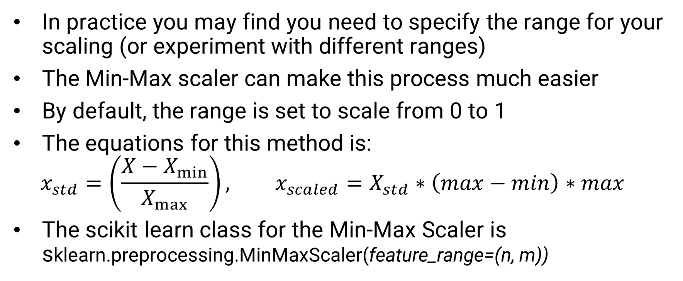
Min-Max Scaling
In practice you may find you need to specify the range for your scaling (or experiment with different ranges)
The Min-Max scaler can make this process much easier
By default, the range is set to scale from 0 to 1
The equations for this method is:
$$x_{std}=\left(\frac{X−X_{min}}{X_{max}}\right), x_{scaled}=X_{std}∗\left(max−min\right)∗max⁡$$
The scikit learn class for the Min-Max Scaler is sklearn.preprocessing.MinMaxScaler(feature_range=(n, m))

Slide 23
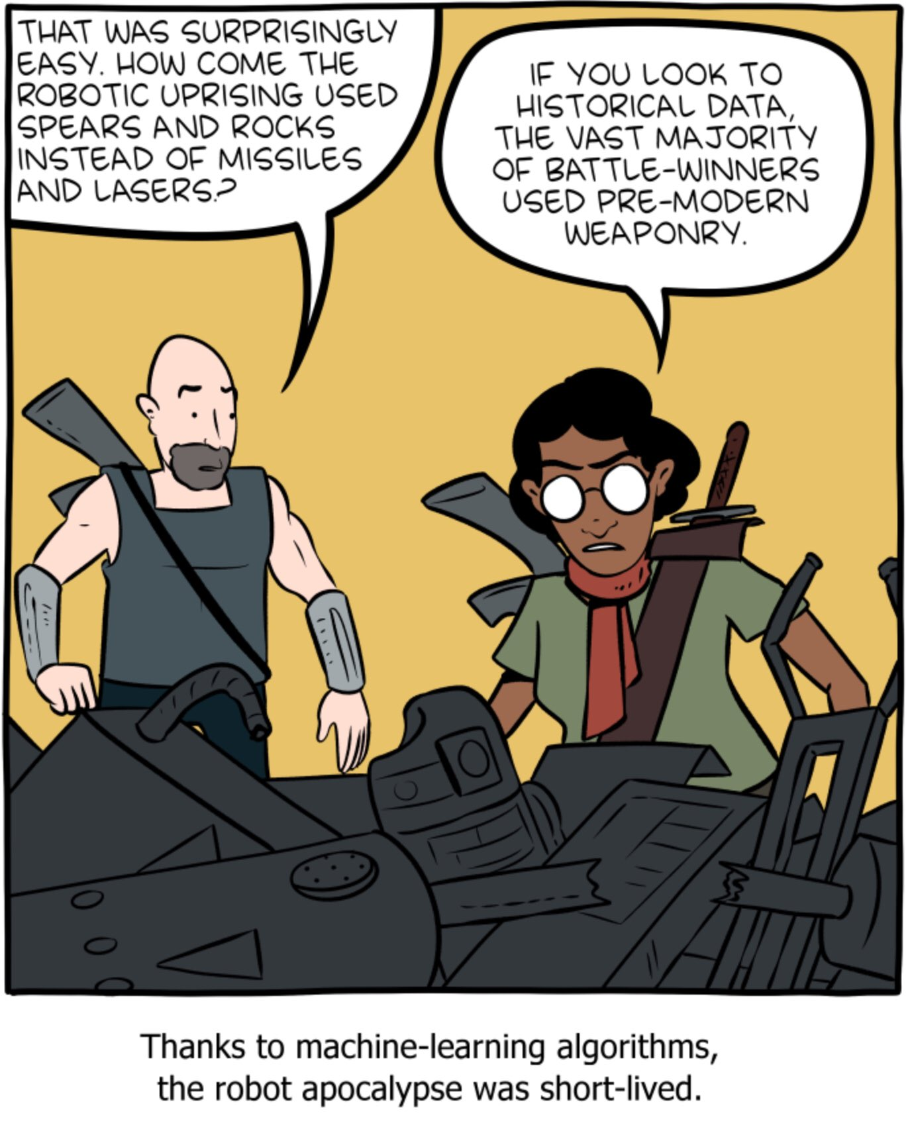
Final Thoughts
Remember Machine Learning relies on Data
Your models will behave as the training data indicates
If your data is flawed your model will be flawed
The more complex your application, the more comprehensive your data needs to be

Slide 24
Next Time
Continue going over the machine learning process
Creating Training & Testing Datasets
Training Linear Regression Models using sklearn
Hyperparameters and Hyperparameter Tunning
Evaluating regression models using sklearn
Homework 5 is due Monday (3/6) before class.

